Slide 1

A Flexible Schedular for Single-Processor Embedded systems for Arduino UNO
Presented BY Mohamed Gamil & Kareem Yasser & Abdelrahman Elsayed
Supervised BY DR.Rami Zeweil

Slide 2

Introduction

Slide 3

Introduction
Cooperative Scheduler

Slide 4
Overview

Slide 5
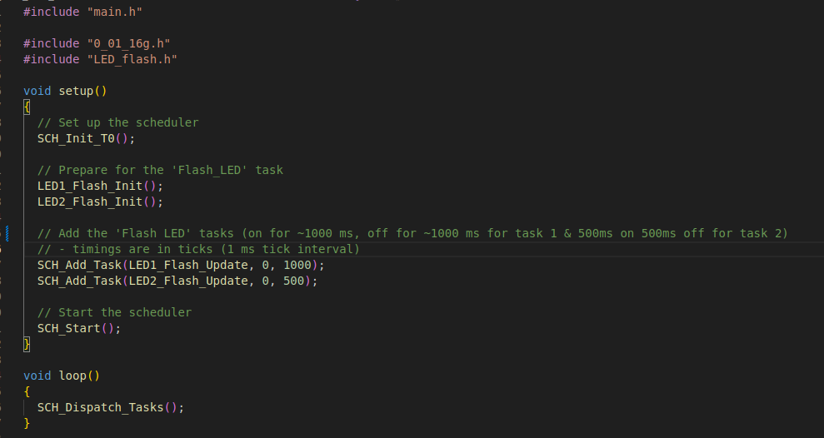
Overview
Main code

Slide 6
Scheduler Data Structure

Slide 7
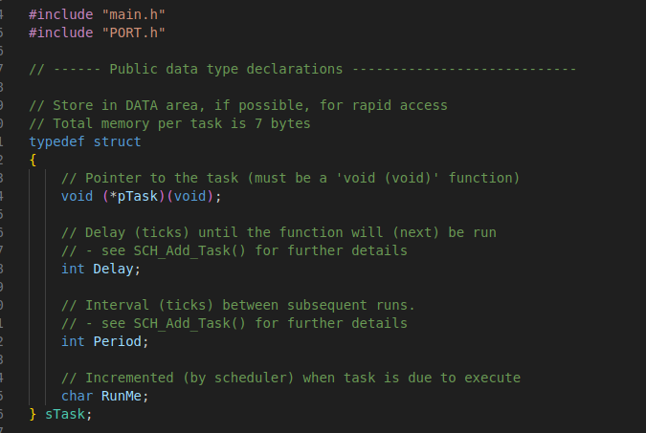
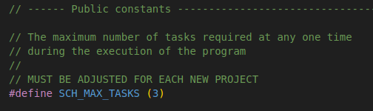
Scheduler Data Structure
SCH328P.h

Slide 8
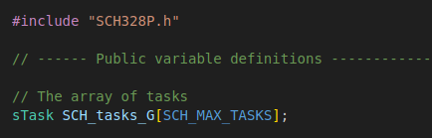
Scheduler Data Structure
SCH328P.h
SCH328P.cpp

Slide 9
Initialization Function (Timer 0)

Slide 10
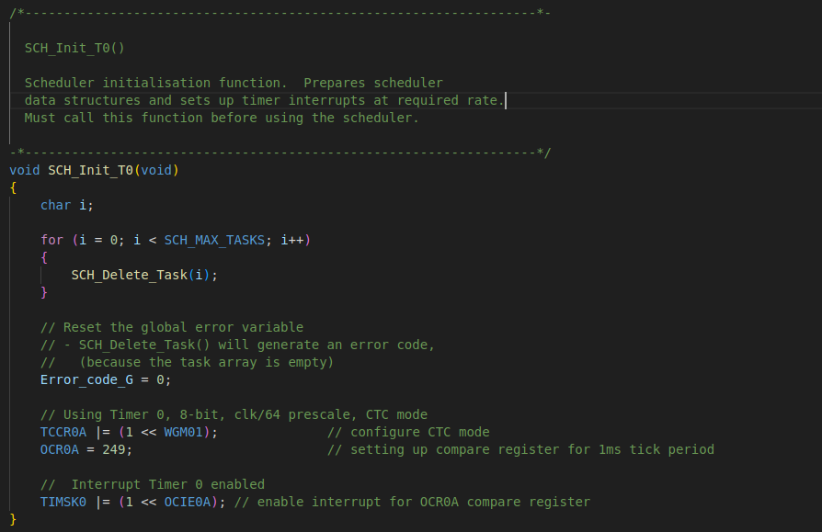
Initialization Function (Timer 0)
0_01_16g.cpp

Slide 11
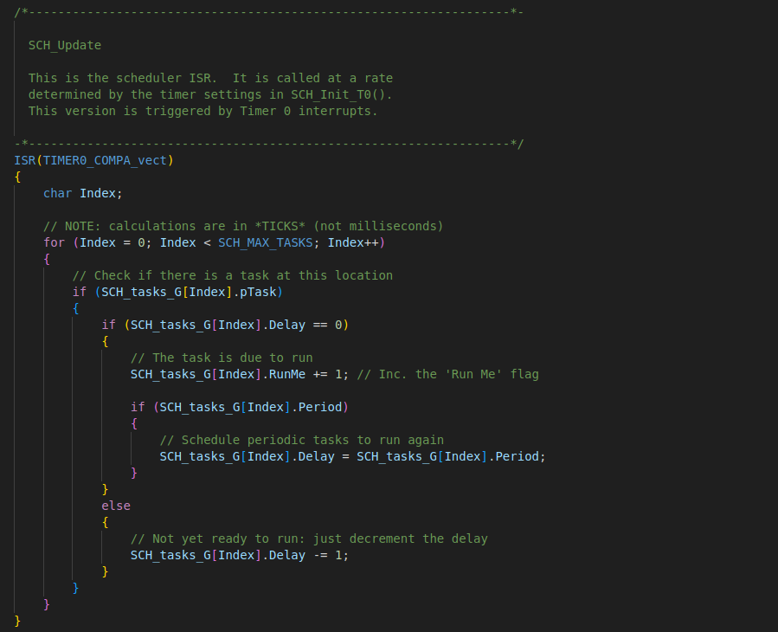
Update Function
0_01_16g.cpp

Slide 12
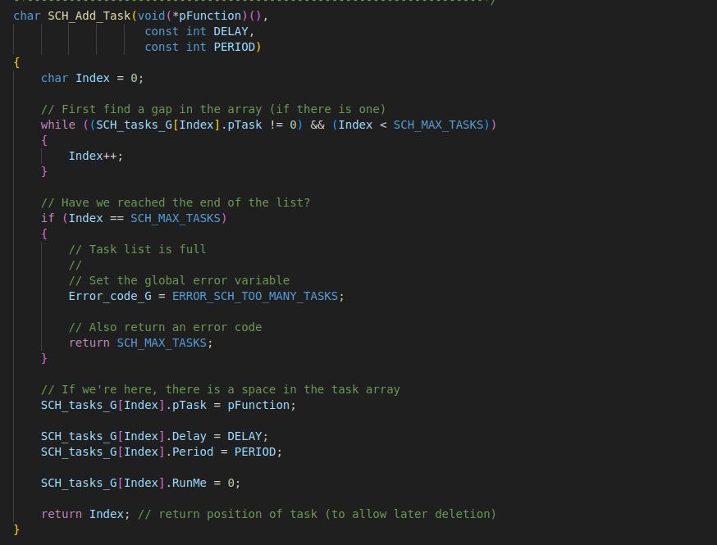
Add Task
SCH328P.cpp

Slide 13
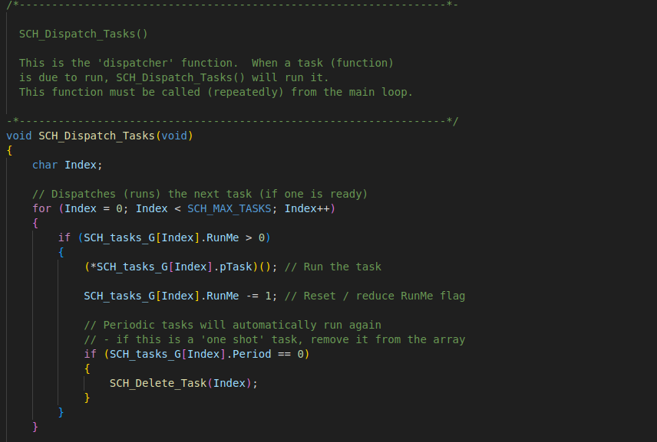
Dispatch Task
SCH328P.cpp

Slide 14
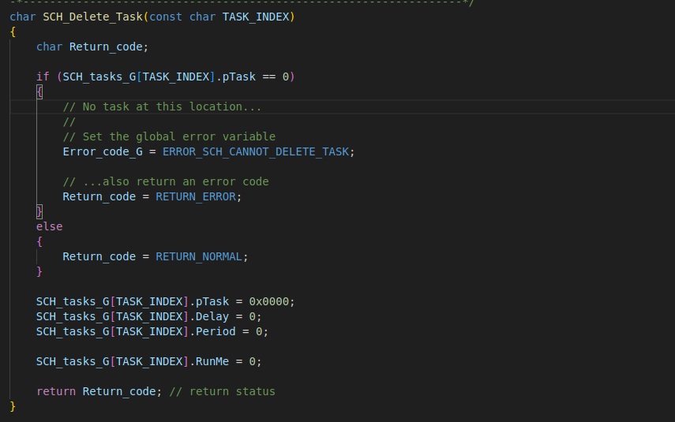
Delete Task
SCH328P.cpp

Slide 15
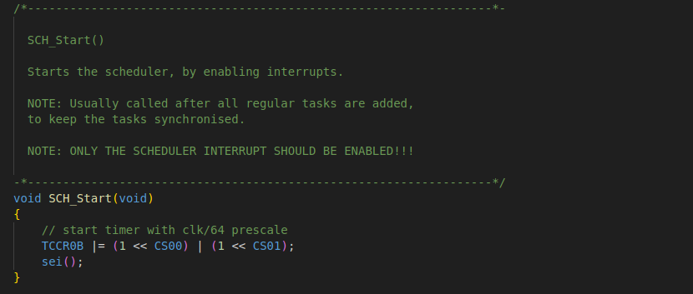
Start Scheduler function
0_01_16g.cpp

Slide 16
Thank You

